Slide 1

D365FO, Git and ALM: how to deliver more, faster
For Less

Slide 2
Synopsis
We'll discuss how to switch and/or start using Git to back your next code repo for D365FO along with process changes to delivery more code faster. We’ll discuss how to use branches, what a pull request is and how to get the most out of your build pipelines when using Git.
PowerPoint available for download at https://github.com/NathanClouseAX/CommunityPresentations/tree/master/2021

Slide 3

Free Stuff
Gift Card Give Away!

Slide 4

Nathan Clouse
Technical Architect enVista Corp.
Microsoft Business Applications MVP
nclouse@envistacorp.com
www.atomicax.com
@NathanClouseAX

Slide 5
Topics
What is Source Control?
TFVC
GIT
Azure DevOps Basics
Getting started with Git
Automation and Actions
YAML
Testing Frameworks
SysTest
ATL
Integrating them into your build
Bringing it all together

Slide 6

What is source control?
Tracks and Manages code
For F&O…
TFVC – Team Foundation Version Control
Git
GitHub
Azure DevOps
GitLab

Slide 7
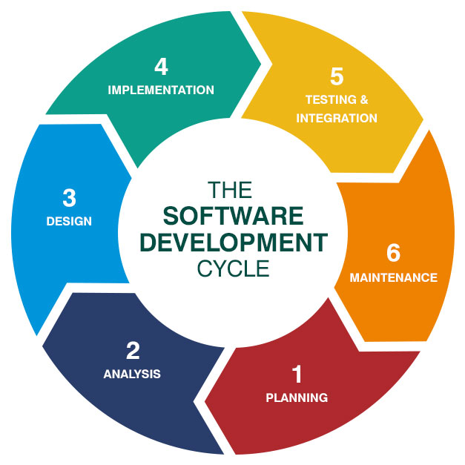
Beyond the Software Development Life Cycle (SDLC)
Not just software development
Not just software delivery
Application delivery and solution management

Slide 8
What is DevOps? What Source Control Should Really do?
Manage
Plan
Create
Verify
Package
Secure
Release
Configure
Monitor
Protect

Slide 9

Why use Git? TFVC works fine.
But TFVC supported
Push based
Branches last nearly forever
Monolithic

Slide 10

Git is Great!
Not Supported
Modern
Pull based
Branches are short lived

Slide 11
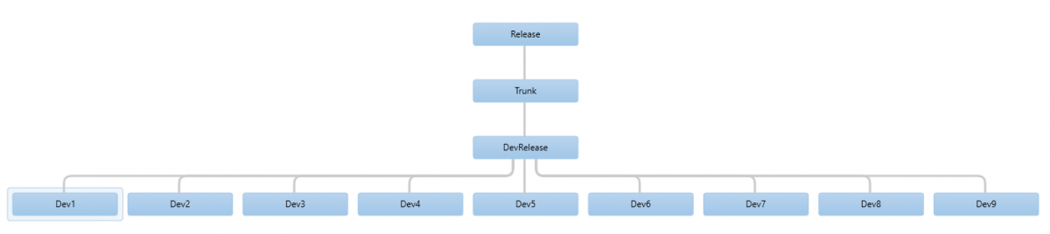
AX 2012 TVFC Example

Slide 12
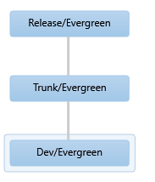
D365 F&O TFVC Example

Slide 13
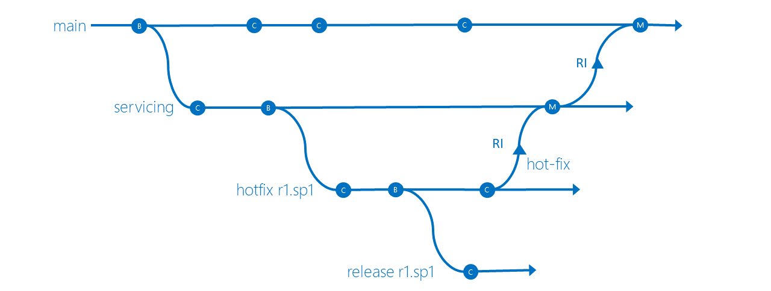
TFVC Conceptual

Slide 14
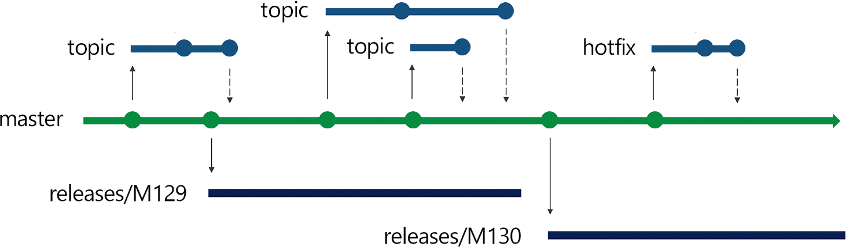
Git Conceptual

Slide 15

TFVC has some good stuff, too!
Shelvesets
Gated Check-ins
http://www.atomicax.com/article/getting-started-gated-checkins
Policies
http://www.atomicax.com/article/getting-started-tfvc-and-d365fo

Slide 16
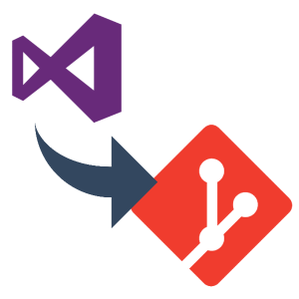
Git Differences
Projects
Need to relocate
Per Package
Instance Directory
Work Offline
Branching
Per work item
Or per requirement
Reviews
Pull Requests

Slide 17
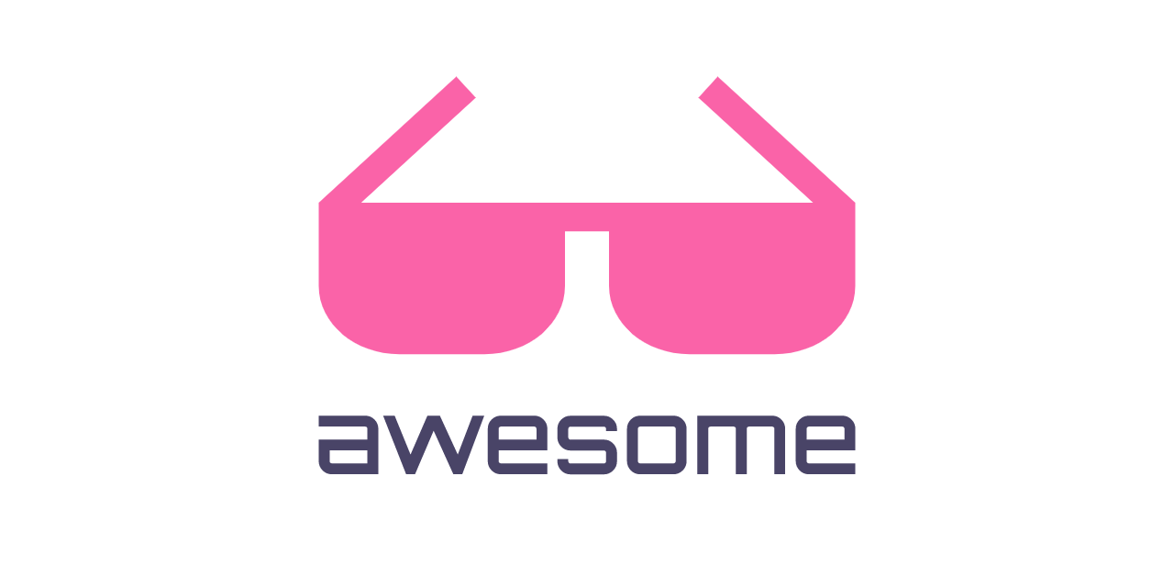
Why I think Git is Better
Modern
Matches how things work in the real world
More “agile”
Meet requirements, 1 at a time
More Tools, More automation, More Actions

Slide 18
Convert to Git today
New Git Repo
New Branch
Move in code
Add .gitignore file
Relocate VS Projects
Clean-up; PR (Pull Request), delete old branch, lock TFVC
More Info: http://www.atomicax.com/article/moving-tfvc-git-azdo

Slide 19
Converting your brain to Git
Change in how you think
Branch per work item
Branch per requirement
How you work
We’re pulling together, not pushing alone

Slide 20
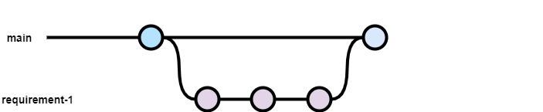
When to Commit

Slide 21

Example of branch strategy
Notes:
Source: https://nvie.com/posts/a-successful-git-branching-model/

Slide 22
Notes:
Source: https://nvie.com/posts/a-successful-git-branching-model/

Slide 23
Example of branch strategy
Notes:
Source: https://nvie.com/posts/a-successful-git-branching-model/

Slide 24
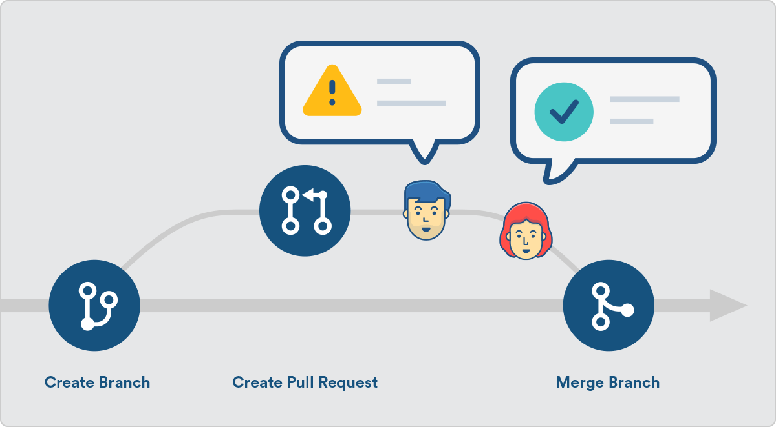
What is a pull request?
Pull requests let you tell others about changes you've pushed to a branch in a repository. Once a pull request is opened, you can discuss and review the potential changes with collaborators and add follow-up commits before your changes are merged into the base branch.

Slide 25

What is a pull request?
Collection of changesets
Call a commit in TFVC terminology

Slide 26
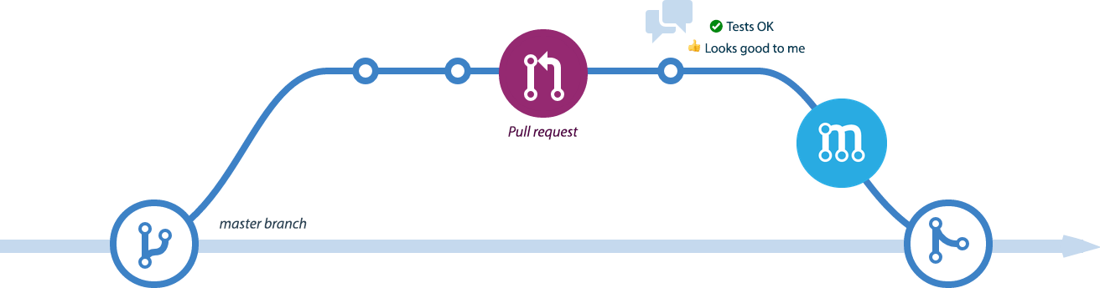
When to Create a pull request
When development is done
Test cases created
Tested
Story Time!

Slide 27
How to Create A Pull Request (PR)
In Visual Studio
In Azure DevOps
GitHub
GitLab
etc.

Slide 28
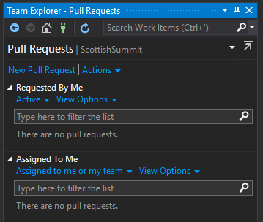
In Visual Studio

Slide 29
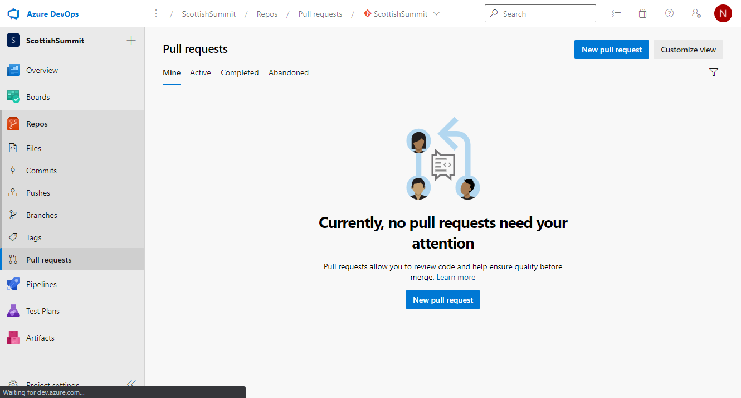
In Azure DevOps

Slide 30

Automation and Actions
Build a pull request before review
Checks for Pull Requests
Automated testing for Pull Requests (Advanced)
Automated Build for Commits (Advanced)

Slide 31
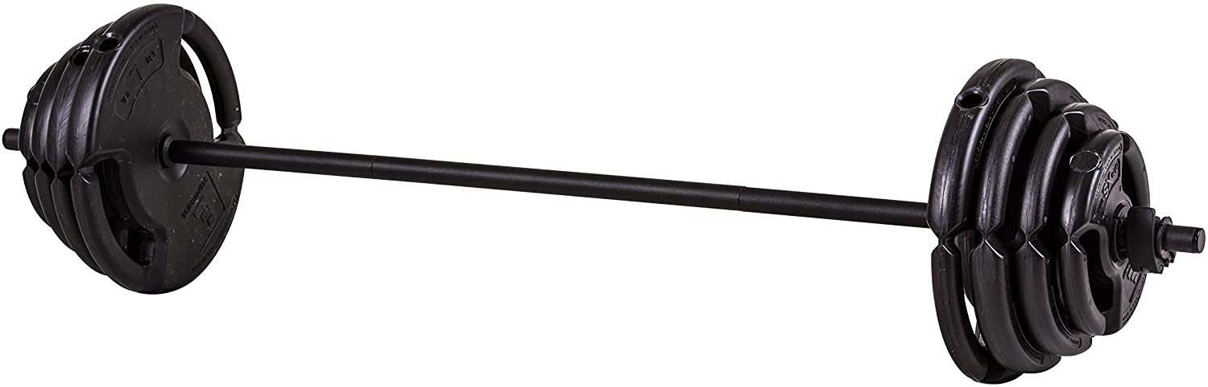
What is a Quality Bar?
Minimum acceptable state for a set of changes
Compiles
Compiles and passes Unit Tests (SysTest)
Compiles and passes Unit Tests (SysTest), ATL tests

Slide 32
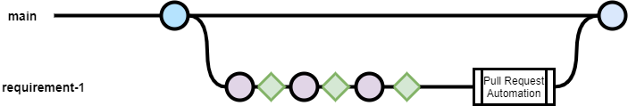
Extended Branch and pull request timeline
Notes:
Pink circle is commit, green diamond is an automated build with email feedback

Slide 33
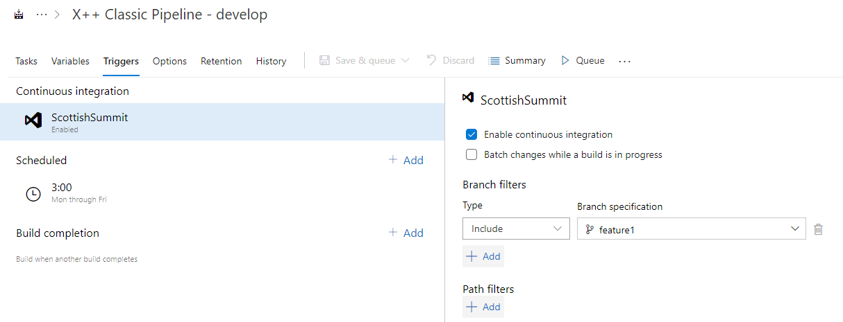
Continuous integration

Slide 34
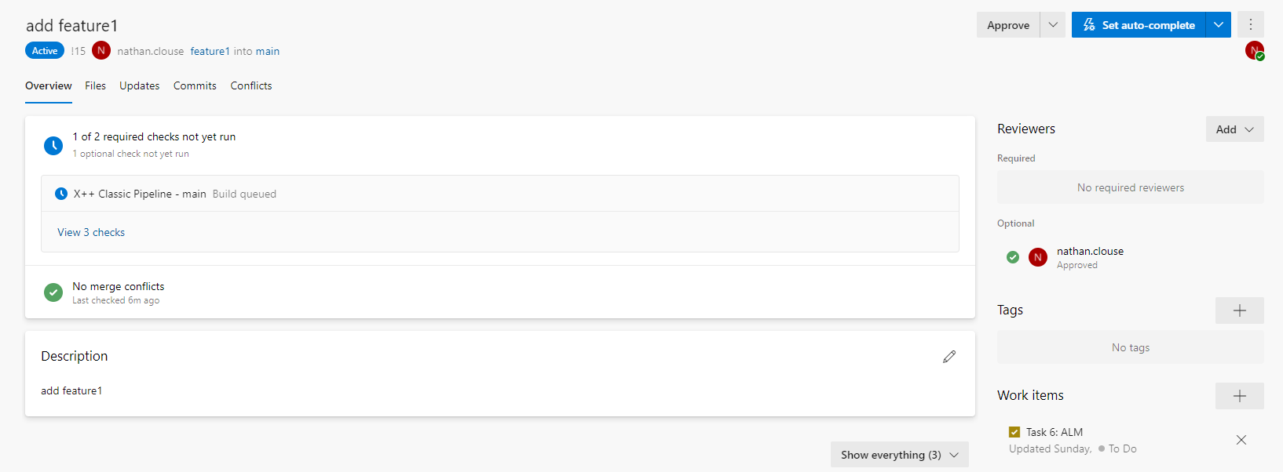
Pull Request Example

Slide 35
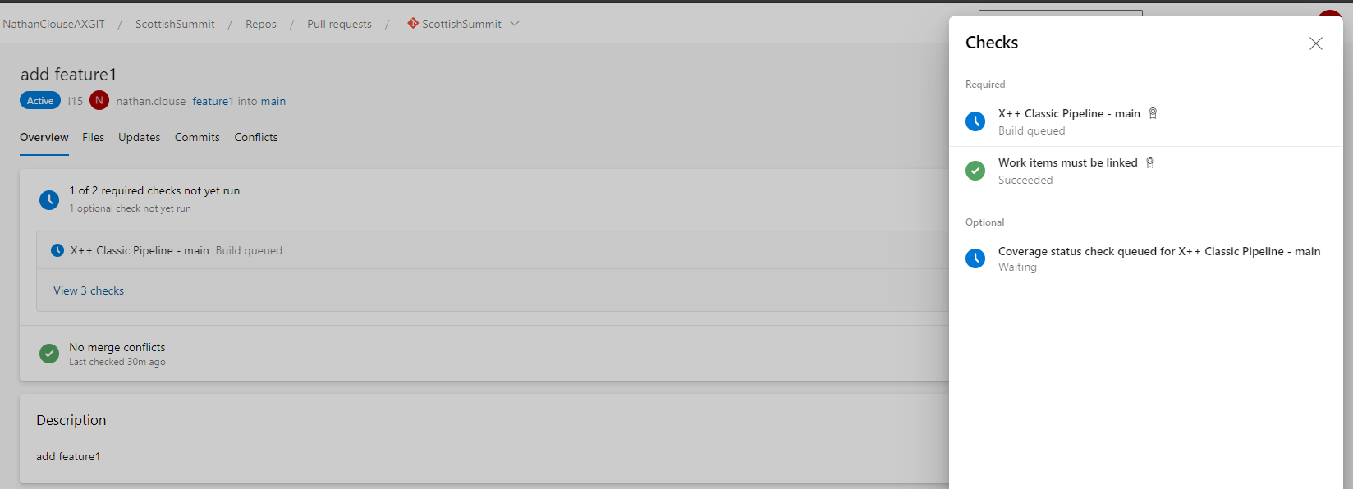
Pull Request Checks

Slide 36
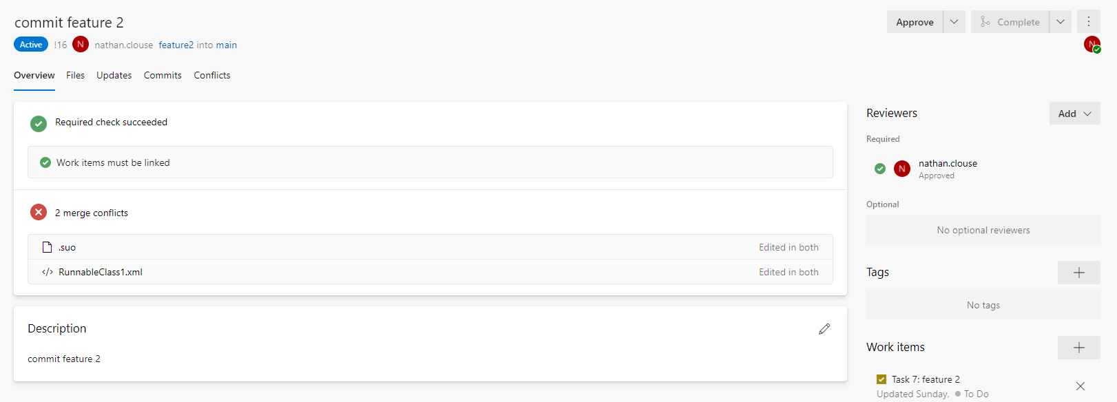
Example Pull Request with Merge Conflicts

Slide 37
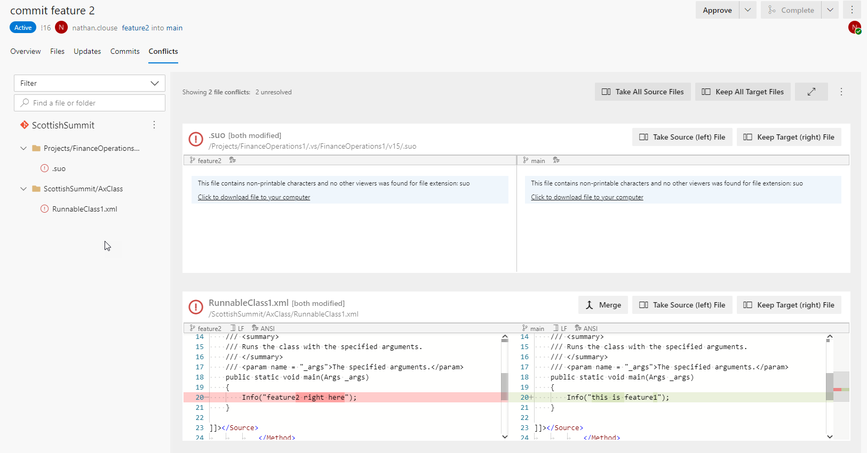
Merge Conflicts

Slide 38
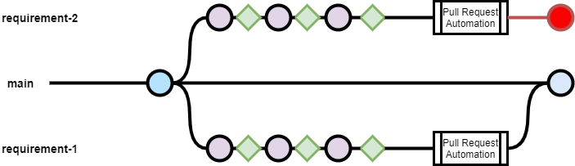
Combined Branch and pull request example

Slide 39
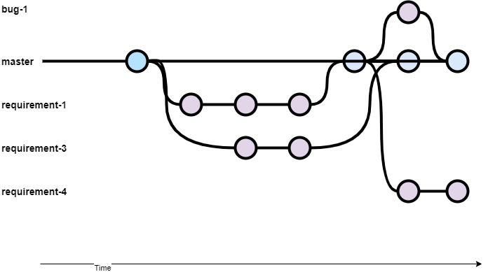
Branch and Resource Management
Notes:
Blue is 1 dev, green is another dev

Slide 40
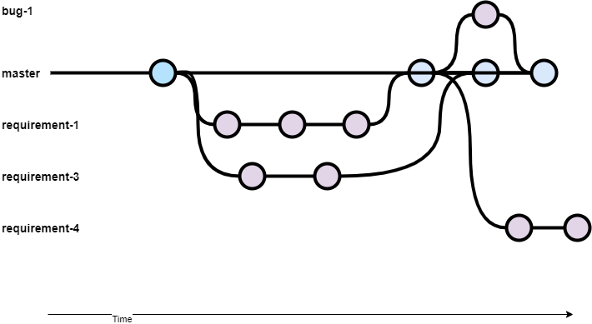
Branch and Commit Management
Notes:
1 dev working on multiple work items

Slide 41
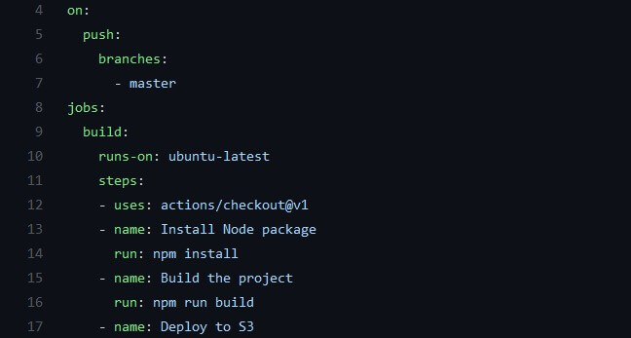
YAML – Pipelines as Code
YAML is a human readable data serialization language
Can be added to source control
Can be used to create pipeline from source control on demand

Slide 42

Testing
SysTest
Automatic discovery
Built into build template*
Used for unit tests
ATL (Acceptance Test Library)
Consistent, Discoverable, Performance
Used for component or simple integration tests

Slide 43
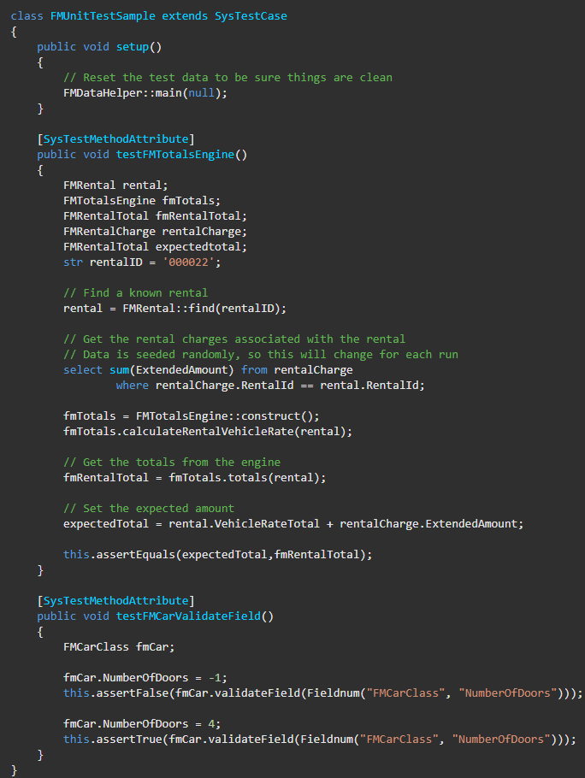
SysTest

Slide 44


Slide 47
SysTest

Slide 48
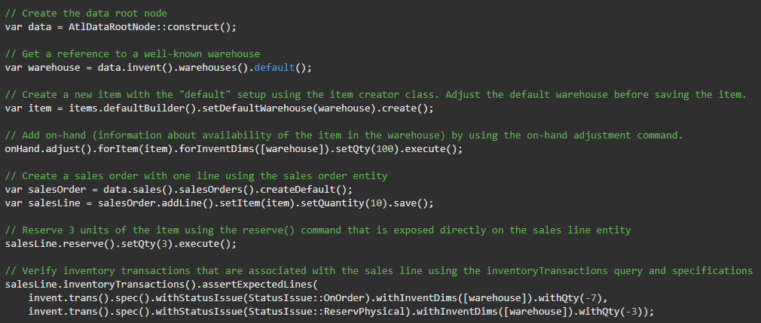
ATL

Slide 51
ATL

Slide 52
Build and Test - Pipelines
Using Serverless Builds
Simple Build
Azure Hosted
Using Dedicated Build Server
Simple Build
Database Sync
Unit Tests
ATL Tests
Doesn’t have to be Azure Hosted

Slide 53
Build and Test - Infrastructure
Azure Hosted
Orchestrated through AZDO Pipelines
Cloud Hosted
Provisioned by LCS
Hosted in Azure
On Premise / Other
Modify VHD from MSFT to function as a build machine
Hosted where you would like
Could be in Azure or On prem

Slide 54

More Info
For more detailed info, please go to:
https://ariste.info/en/msdyn365-azure-devops-alm

Slide 55
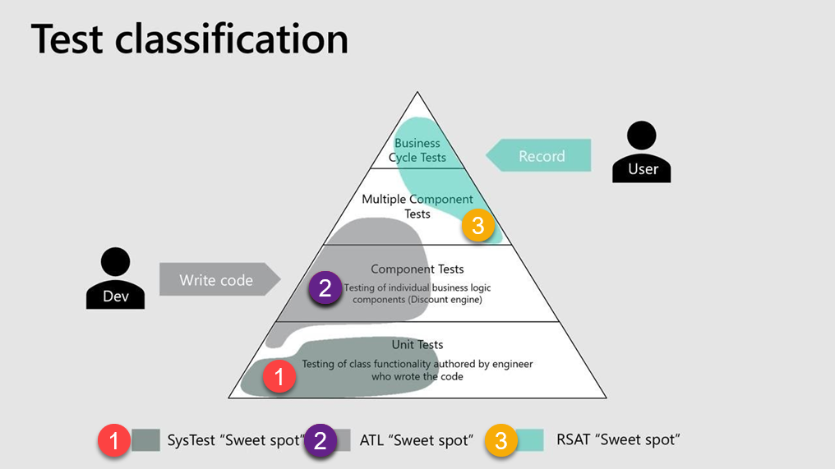

Slide 56
Automated Releases
Standard
Release Package to LCS
Release Package to UAT
Cannot Release to PROD using automation
D365FO.Tools (+ LCS APIs)
Start / Stop Environments
Get Environment Metadata
Get Environment History
List Database Backups in LCS
Export Databases from T2+
Refresh PROD database to Sandbox
Get Operation Status

Slide 57
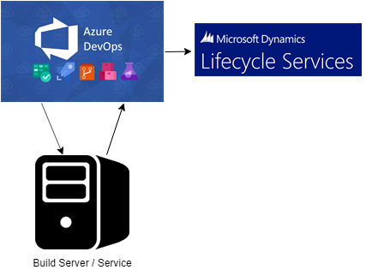
Release to LCS
Stores result in LCS for your build in your asset library
Easy to select from
No additional fuss
Period manual cleanup in LCS

Slide 58
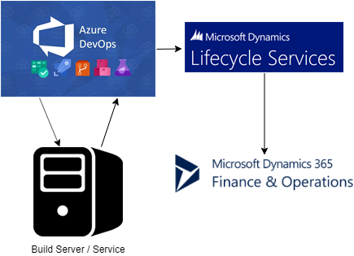
Release to Sandbox
Automatic deployment to a standard environment like UAT
PROD / Operations not supported

Slide 59
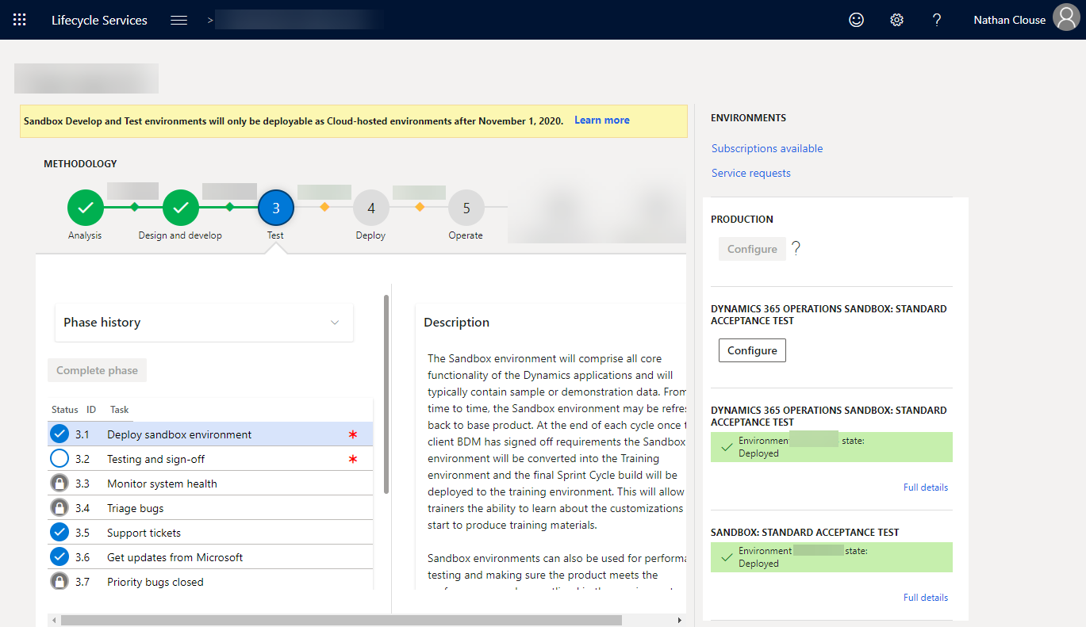

Slide 60

F&O Pipelines
For more detailed info on how to configure this, please see:
https://ariste.info/en/2019/02/setting-up-release-pipeline-in-azure-devops-for-dynamics-365-for-finance-and-operations/

Slide 61
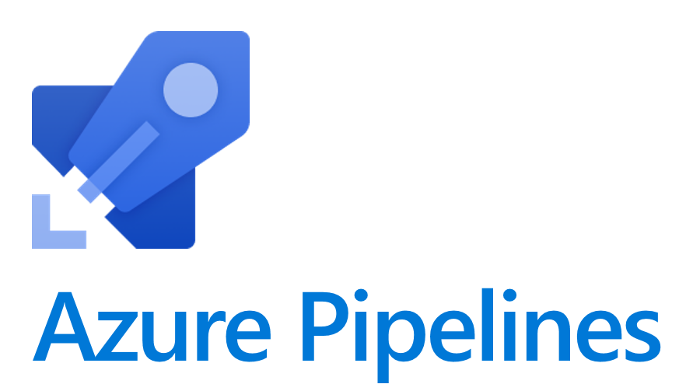
Start/Stop Environments (D365FOTools)
Use Pipeline to execute PowerShell Commands
Start/Stop Environments that allow operation from Azure DevOps rather than LCS
Can be scheduled
Turn on T1 VMs at 7:30 AM
Turn off T1 Vms at 5:30 PM

Slide 62

Get Environment Metadata (D365FOTools)
Get info about a specific environment
Name
Type
Deployment State
Current Application Version
Deployment Status
Can Start / Stop

Slide 63
Get Environment History (D365FOTools)
See history events for an environment
Name
Type
Type Display
Status
Start / Stop DateTime

Slide 64
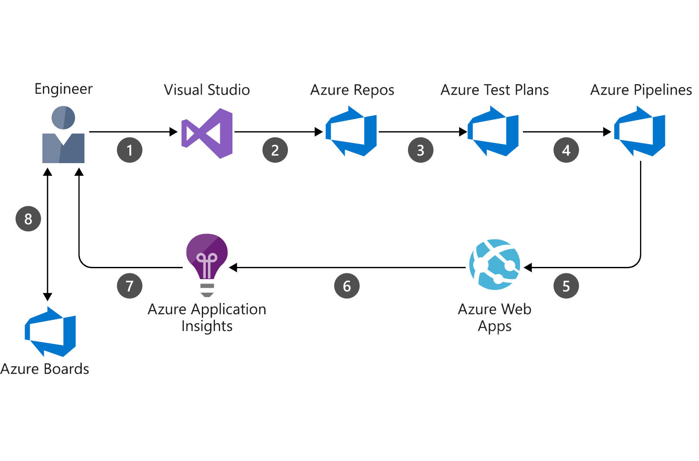
New Feedback Loop
LCS
LCS

Slide 65
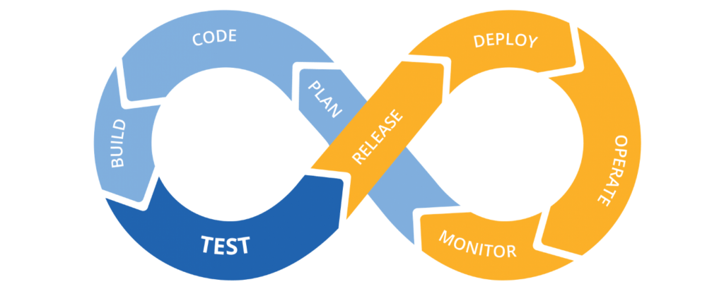
New Feedback Loop

Slide 66
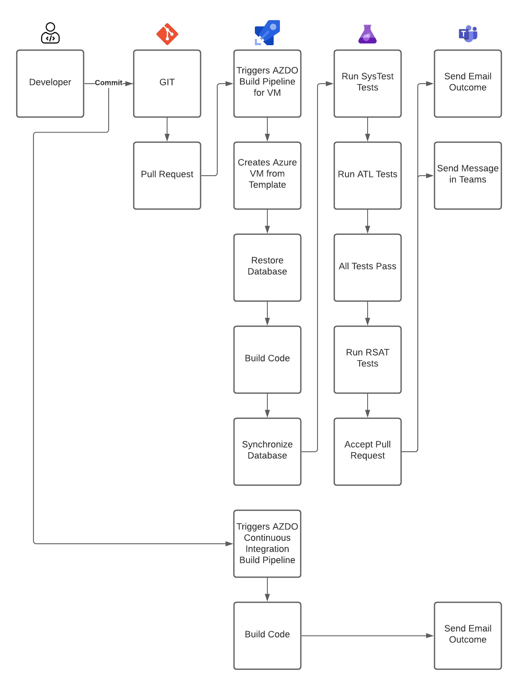
The Possibilities

Slide 78
The Possibilities

Slide 79


Slide 80
Sources
http://www.atomicax.com/article/giting-started-git-d365fo-and-other-puns
http://www.atomicax.com/article/getting-started-gated-checkins
http://www.atomicax.com/article/moving-tfvc-git-azdo
http://www.atomicax.com/article/getting-started-tfvc-and-d365fo
http://www.atomicax.com/article/why-gated-check-ins-are-awesome
http://www.atomicax.com/article/staging-and-git
https://ariste.info/en/msdyn365-azure-devops-alm/

Slide 81
Sources
https://msdyn365fo.wordpress.com/2020/02/06/msdyn365fo-build-with-yaml-file-the-future-is-now/
https://docs.microsoft.com/en-us/azure/devops/pipelines/yaml-schema?view=azure-devops&tabs=schema%2Cparameter-schema
https://github.com/microsoft/Dynamics365-Xpp-Samples-Tools/tree/master/CI-CD/Pipeline-Samples
https://msdyn365fo.wordpress.com/2021/04/

Slide 82
Sources
https://docs.microsoft.com/en-us/dynamics365/fin-ops-core/dev-itpro/perf-test/testing-validation
https://docs.microsoft.com/en-us/dynamics365/fin-ops-core/dev-itpro/perf-test/acceptance-test-library?WT.mc_id=BA-MVP-5003744
https://www.powerazure365.com/blog-1/automate-your-tests-for-dynamics-365-finance-and-operations

Slide 83

In summary
GIT can help take your delivery to the next level with automation in:
Build
Test
Deployment
Management

Slide 84
Questions?

Slide 85
Dynamics 365: Let’s talk Upgrade Rollout Approach (AX 2012 Upgrade Series: Part 6) – Tuesday @ 2:00
Dynamics 365 F&O Licensing, Upgrades, Costs and More (Part 2) – Tuesday @ 3:00
Retail and Warehousing: The Biggest Areas for Change in Dynamics 365 F&O (AX 2012 Upgrade Series: Part 3) – Wednesday @ 9:30
AX Sucks. Let’s talk Upgrades (AX 2012 Upgrade Series: Part 1)– Wednesday @ 10:30
An AX2012 Upgrade Journey - Wednesday @ 11:30
Dynamics 365 F&O Business Events From End to Start to End – Wednesday @ 1:40
Dynamics 365 F&O Upgrade Tech Talk: Code, Customizations, Extension and Power Platform (AX 2012 Upgrade Series: Part 5) – Thursday @ 10:00
How To Get The Most Out of Your Upgrade (AX 2012 Upgrade Series: Part 2) – Thursday @ 1:10

Slide 86
My Other Presentations
Dynamics 365 F&O Business Events From End to Start to End – Wednesday @ 1:40
Dynamics 365 F&O OData From Zero To Hero – Thursday @ 9:00
F&O Integration Roundup - Thursday @ 11:00
X++ Development Tips and Tricks plus D365FO.Tools! – Thursday @ 2:10

Slide 87
Give Away!

Slide 88
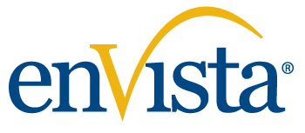
Please visit our booth
enVista booth #700
Meet with our experts
Learn about industry-leading practices
Get the most from your Microsoft investments
Register to win a YETI™ cooler
enVista
Booth
Hall C Entry

Slide 89
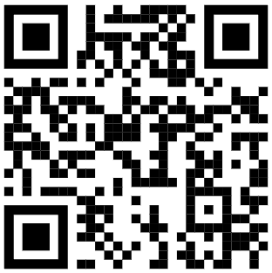
Survey Code

